Slide 1
IoT Smart Door System
H O S T : G U Y TEL Z U R
S T U D E N T D S : Yehonatan Dadkha, Adar Shapira.

Slide 2
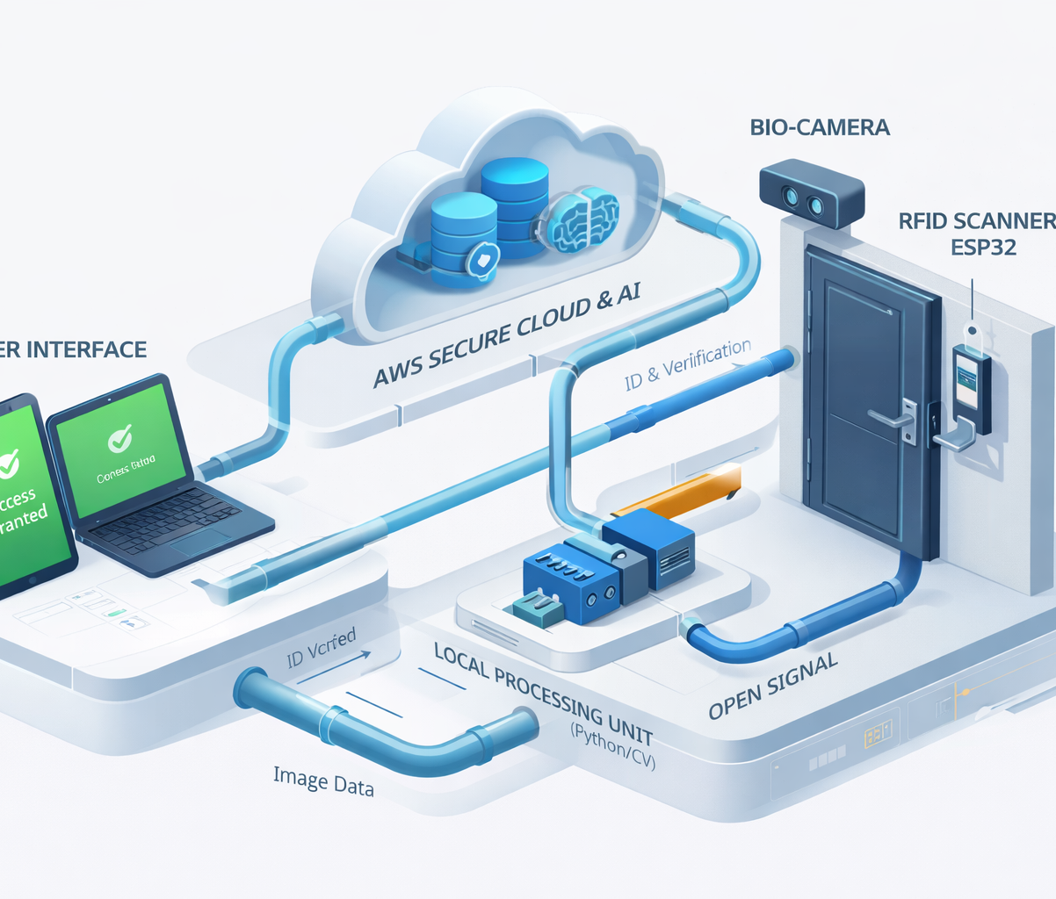
Agenda
What is IoT Smart Door System?
Background & Related work
Challenges
System Architecture
Implementation
Future Ideas
Summary

Slide 3
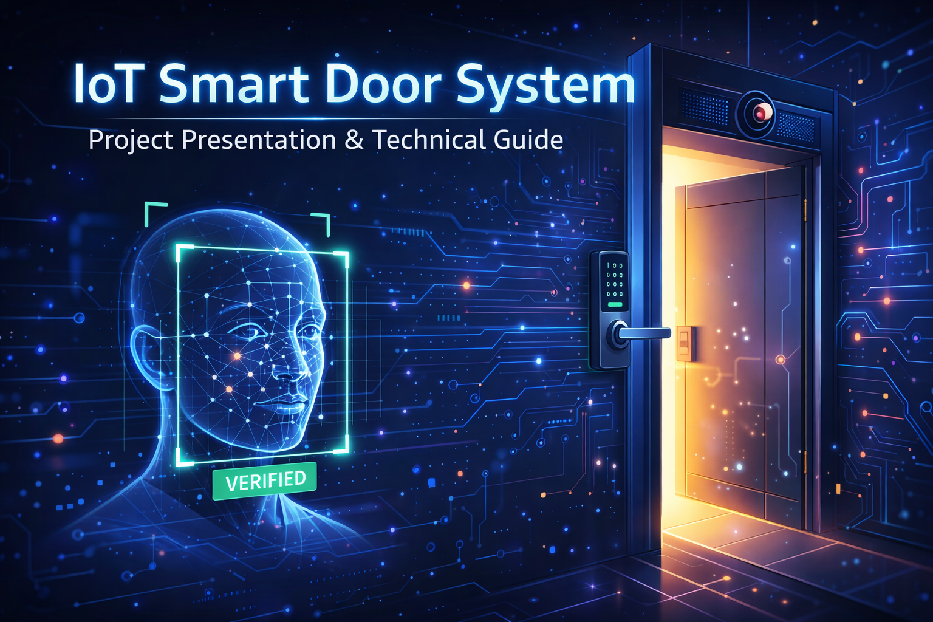
What is IoT Smart Door System?

Slide 4

What is IoT Smart Door System?
IoT-based smart door system is a security system designed to manage physical access and identity verification, getting real-time biometric and RFID data from IoT devices installed at the entrance communicating over a secure cloud network.

Slide 5
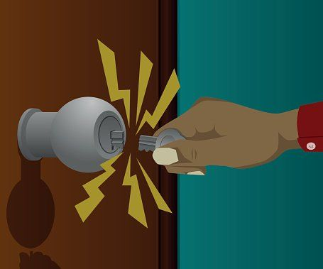
What is IoT Smart Door System?
Issues
Secure Access Control (Preventing unauthorized entry & key loss)
Biometric Identity Verification (Face recognition & MFA)
Data gathering, storage & Security (Secure logging of entry events)
UI for easy management & monitoring (Admin dashboard for viewing logs)
Contactless User Experience (Fast, hygienic, and seamless entry)

Slide 6
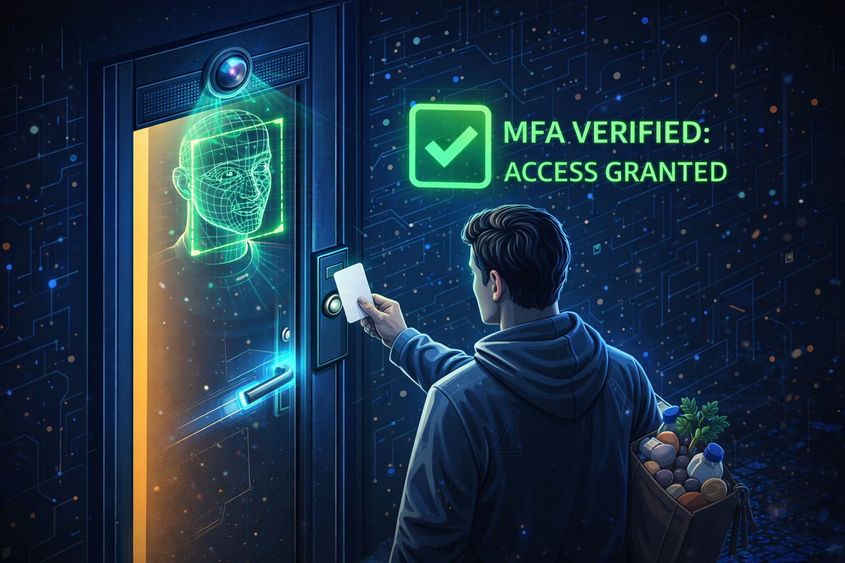
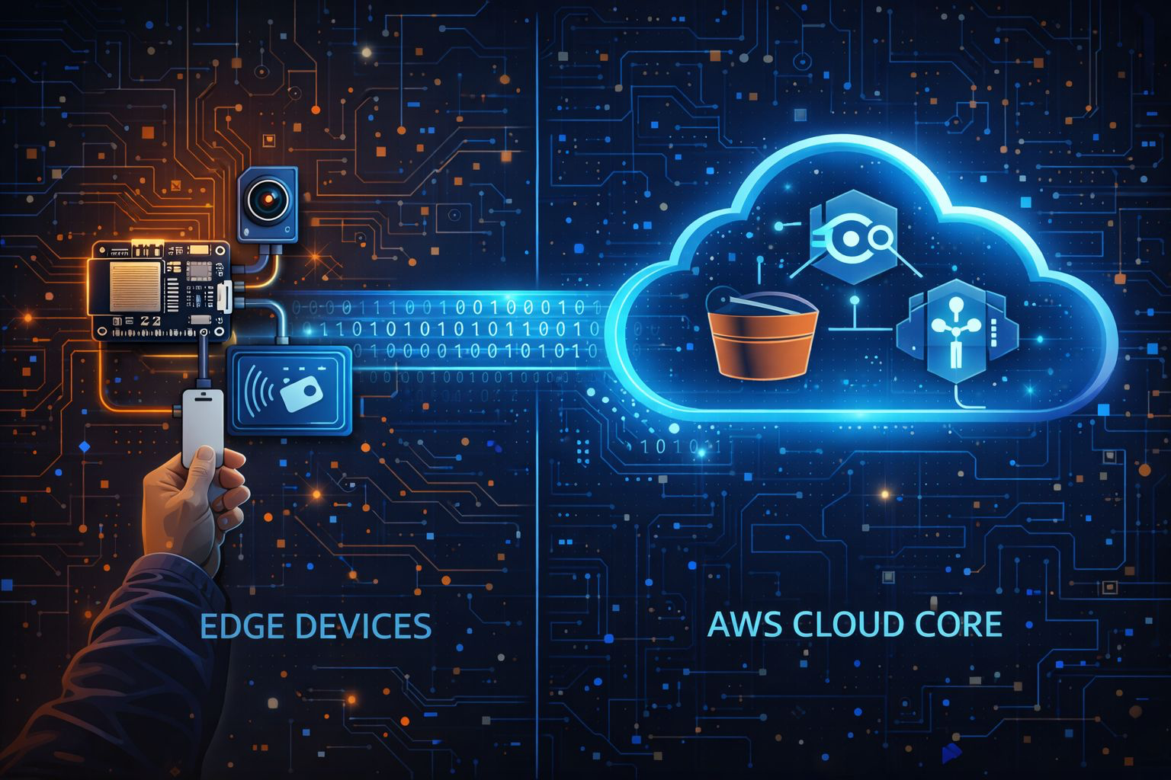
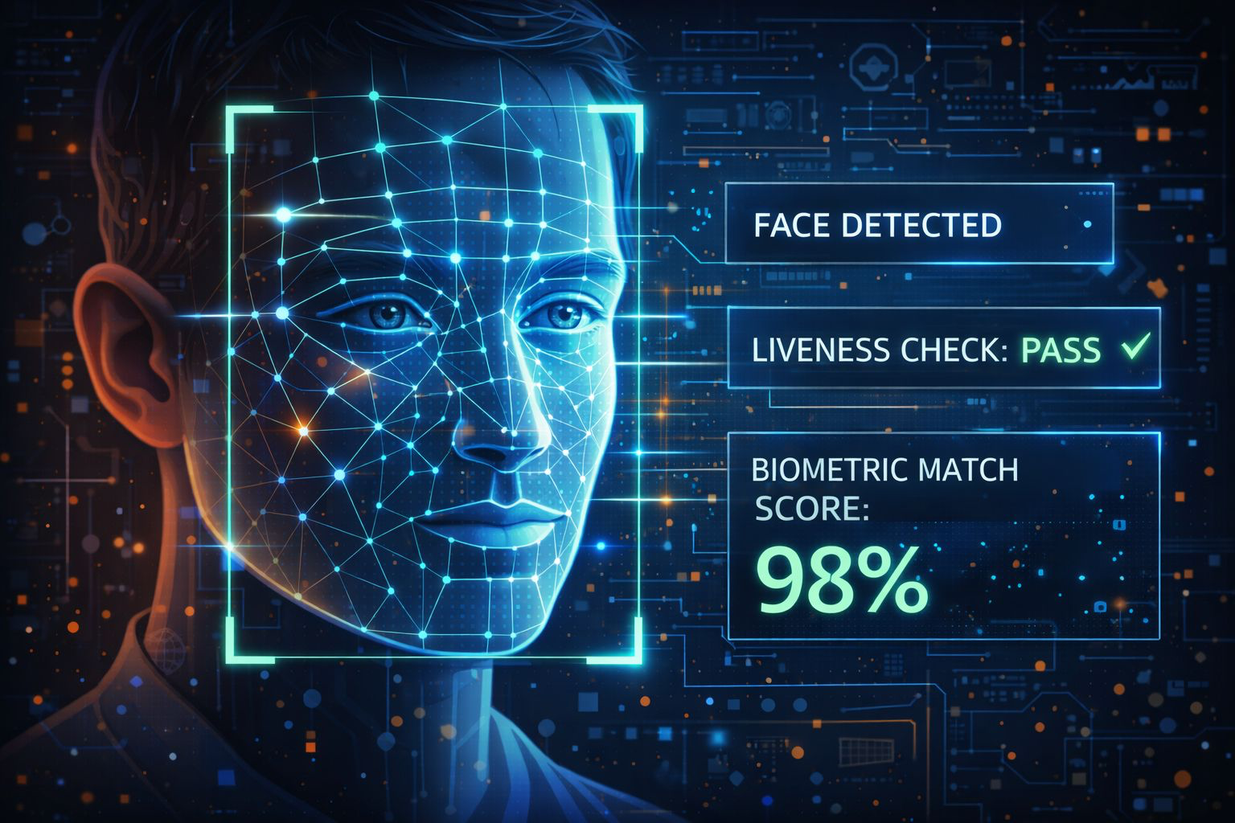
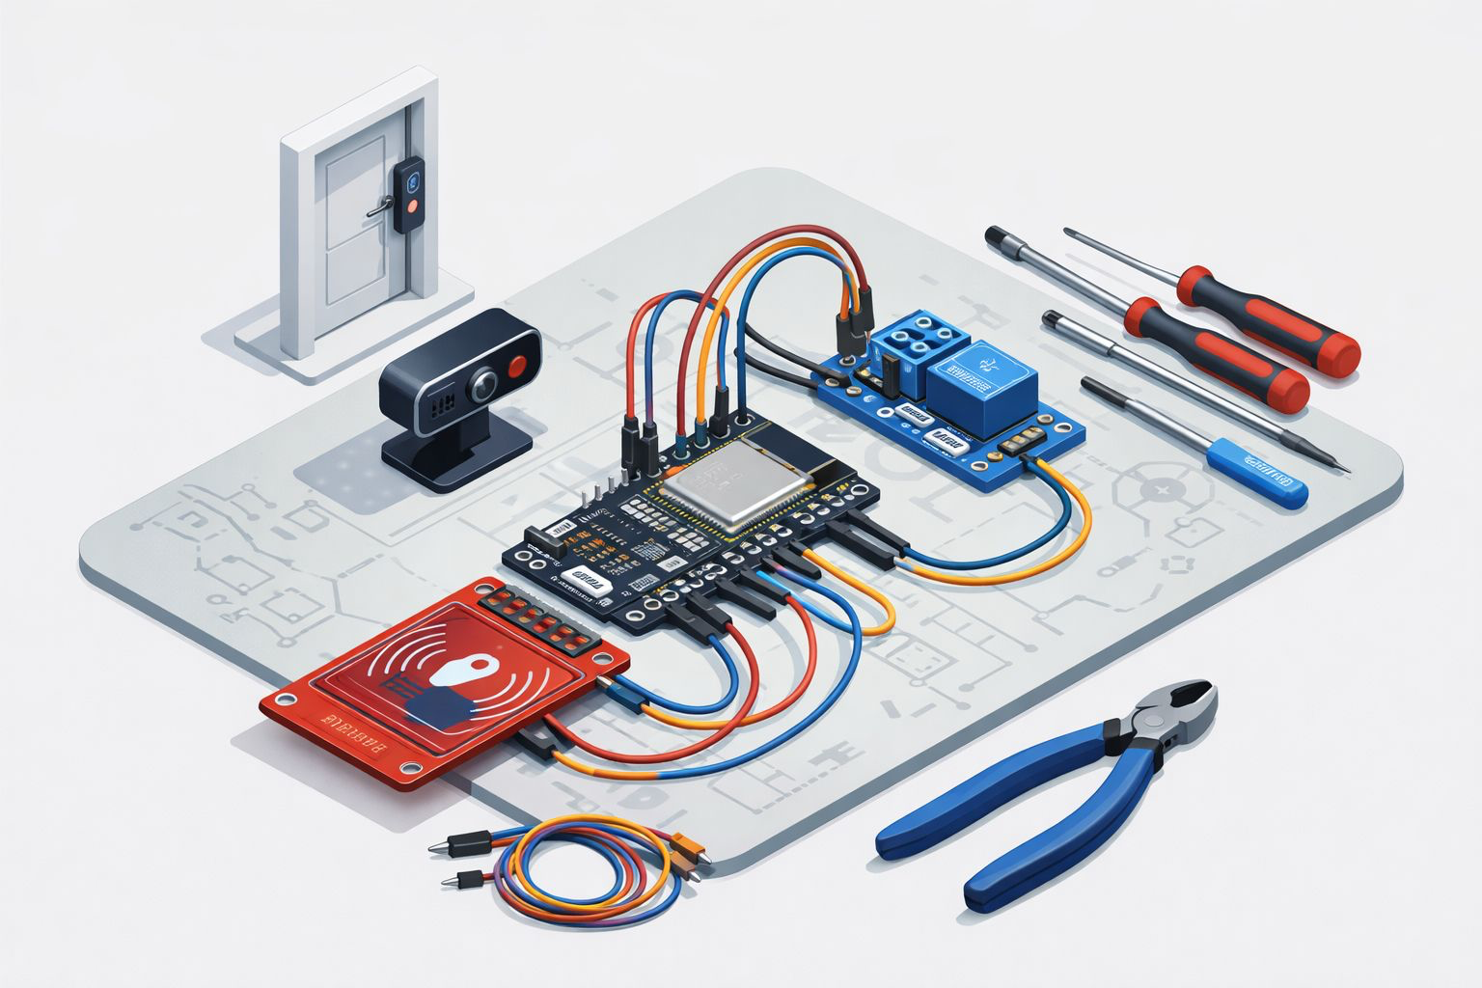
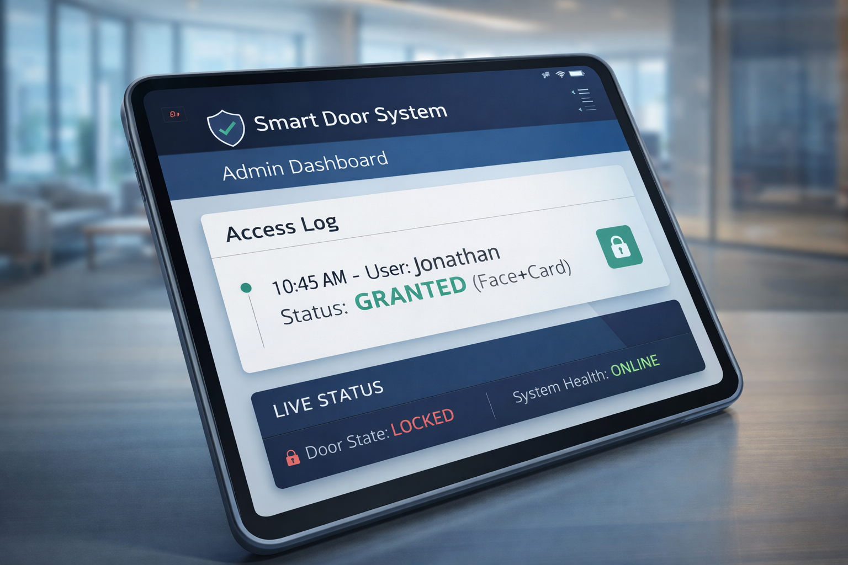
What is IoT Smart Door System?
The "Money Shot"
Edge to Cloud
Computer Vision
The Prototype Setup
Admin Dashboard

Slide 7


Slide 8
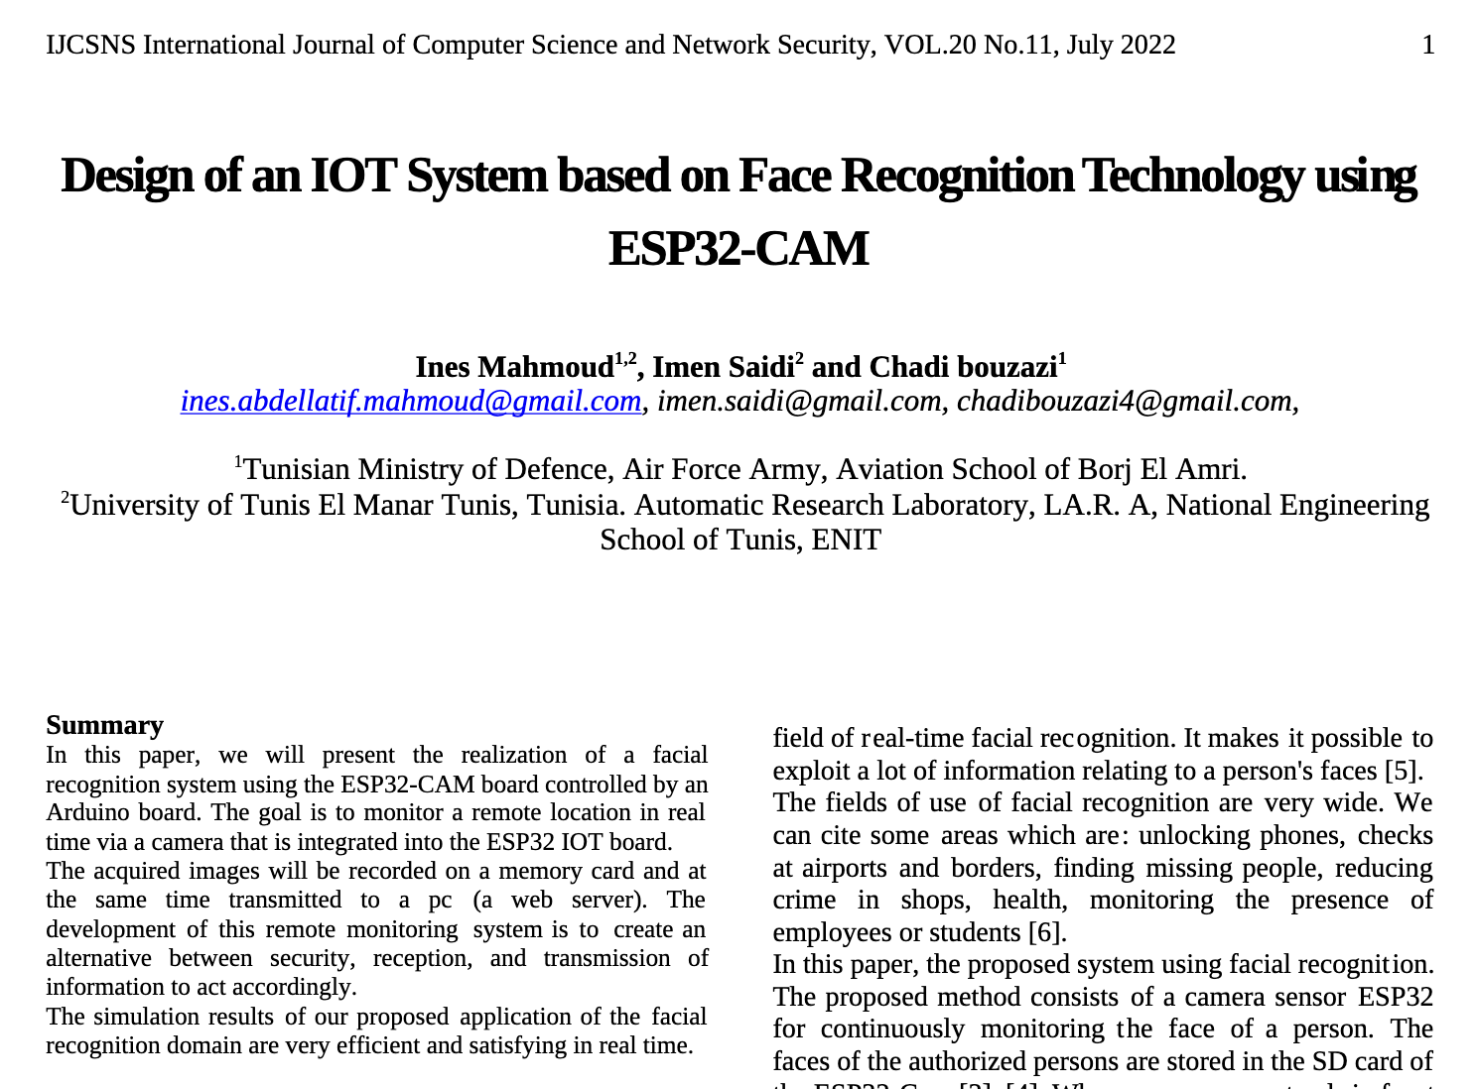
Background & Related work
Title: Design of an IOT System based on Face Recognition Technology using ESP32-CAM Authors: Ines Mahmoud, Imen Saidi, Chadi Bouzazi
Publish date: July 2022
Publisher: IJCSNS (International Journal of Computer Science and Network Security)
This paper presents the design of a real-time IoT security system that utilizes an ESP32-CAM module controlled by an Arduino board to perform face recognition against a local SD card database and transmit video streams to a remote web server for monitoring.

Slide 9
Background & Related work
System configuration and Implementation
Input
Processing Unit
Output / User Interface
OV2640 Camera
(Integrated Lens)
Image
ESP32-CAM
(AI-Thinker Mod)
Wifi Stream
Web Server
(Browser UI)
Storage
SD Card
(Image Database)

Slide 10
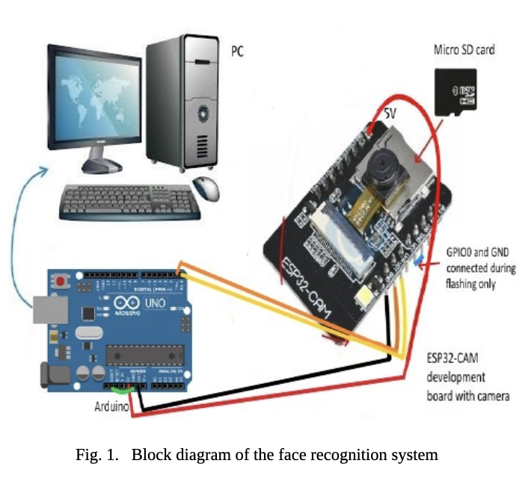
Background & Related work
Results
Recognition Logic: The system logic is configured to identify users based on database matching: if (Face_Match_Score > Threshold) { Status = "Authorized: [Name]" } else { Status = "Unknown Person" }.
Accuracy & Robustness: The system was tested on a dataset of 10 people with 100 images each, capturing different facial expressions (neutral, angry, happy). The simulation showed efficient real-time recognition even with changing grimaces and positions.
Evaluation Output: Results were monitored via a Web Browser stream (IP Camera) and data was automatically logged into an Excel file recording the Person's Name, Date, and Time of detection.

Slide 11
Background & Related work
Summary
[X] Cloud integration wasn’t mentioned, relying solely on local SD card storage and a local Web Server.
[X] Scalability is limited as the system database is manually created on a memory card rather than a dynamic cloud database.
[X] Data handling is basic, storing entry logs in a local static Excel file instead of a managed database system.
[X] Security protocols (like encryption or anti-spoofing) were not discussed, despite the focus on "security" applications.

Slide 12
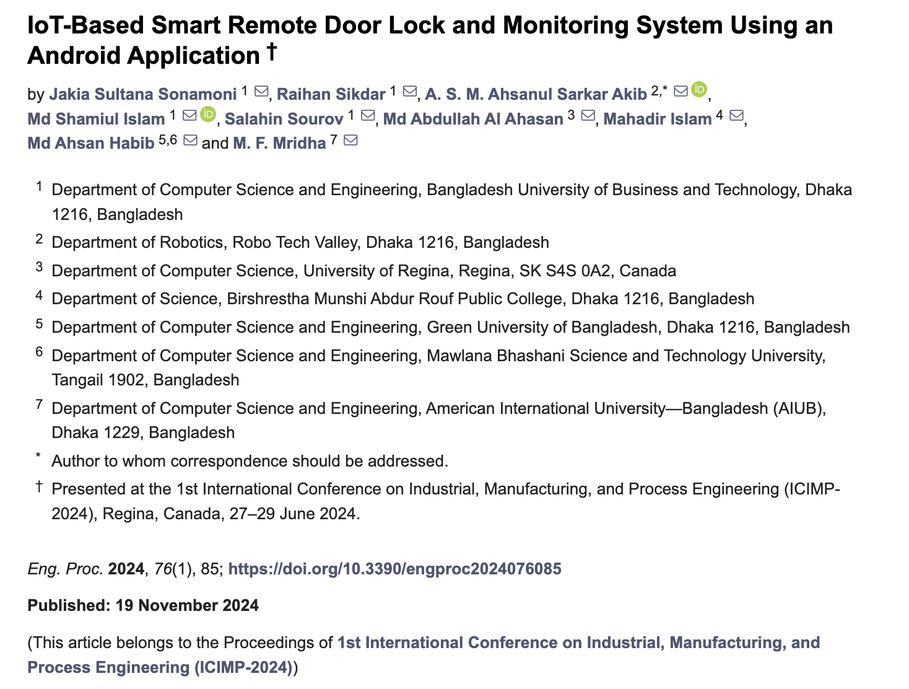
Background & Related work
Title: IoT-Based Smart Remote Door Lock and Monitoring System Using an Android Application.
Authors: Jakia Sultana Sonamoni, Raihan Sikdar, A. S. M. Ahsanul Sarkar Akib, Md Shamiul Islam, Salahin Sourov, Md Abdullah Al Ahasan, Mahadir Islam, Md Ahsan Habib, and M. F. Mridha.
Publish date: 2024.
Publisher: MDPI (Engineering Proceedings).
Article focuses about the problems such as the security risks associated with physical keys (loss, theft, or copying) and the uncertainty regarding the door's lock status. Challenges being dealt with are: remote monitoring and controlling of the door via an Android application, visitor verification through image capture, and real-time theft alerts.

Slide 13
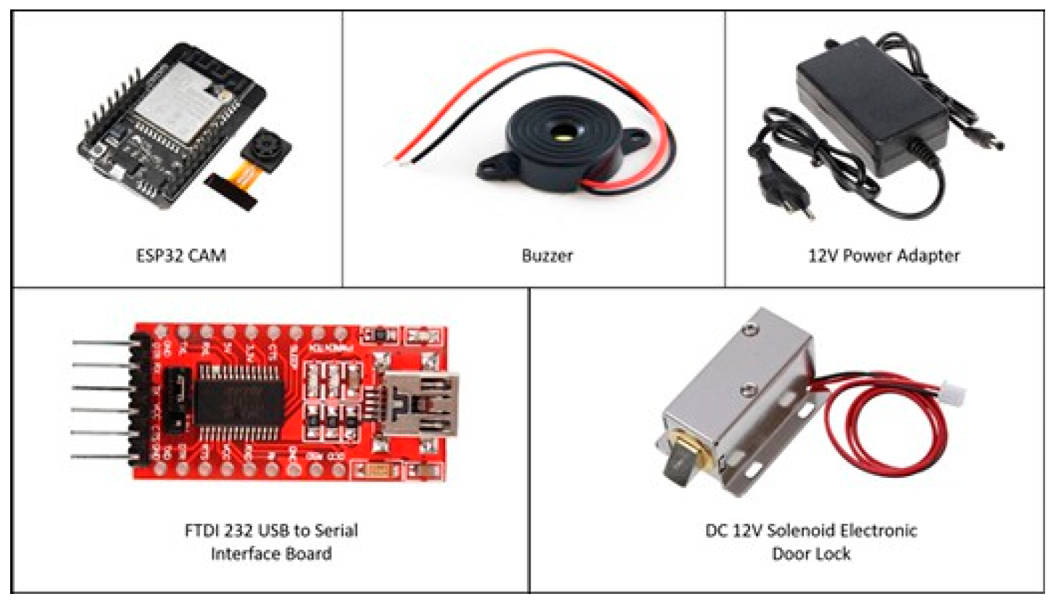
Background & Related work
System configuration and Implementation
ESP32-CAM module (Microcontroller with built-in video camera, Wi-Fi, and Bluetooth).
DC 12V Solenoid Electronic Door Lock (Electromagnetic locking mechanism).
Blynk Android Application (IoT platform for remote monitoring, image capturing, and lock control).
Buzzer (Audio signaling tool for theft alerts).
Power Supply (12V Power Adapter and 18650 Lithium-Ion Battery).
FTDI 232 USB to Serial Interface Board (Used for programming the ESP32-CAM).
Circuit Components (TIP122 transistor, 7805 5V regulator, 1N4007 diode, resistors, and push button).
Android Studio (Used for running/developing the application context).

Slide 14
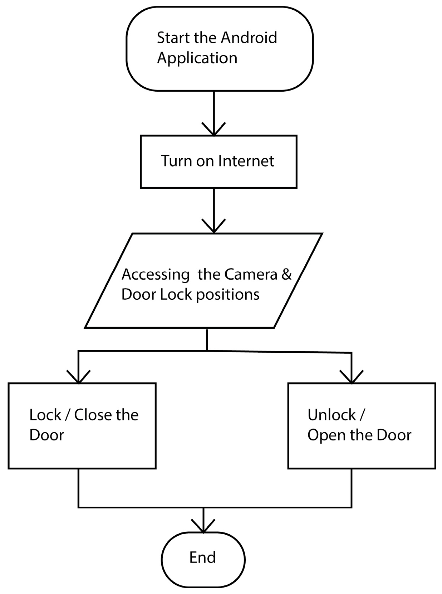
Background & Related work
System configuration and Implementation

Slide 15
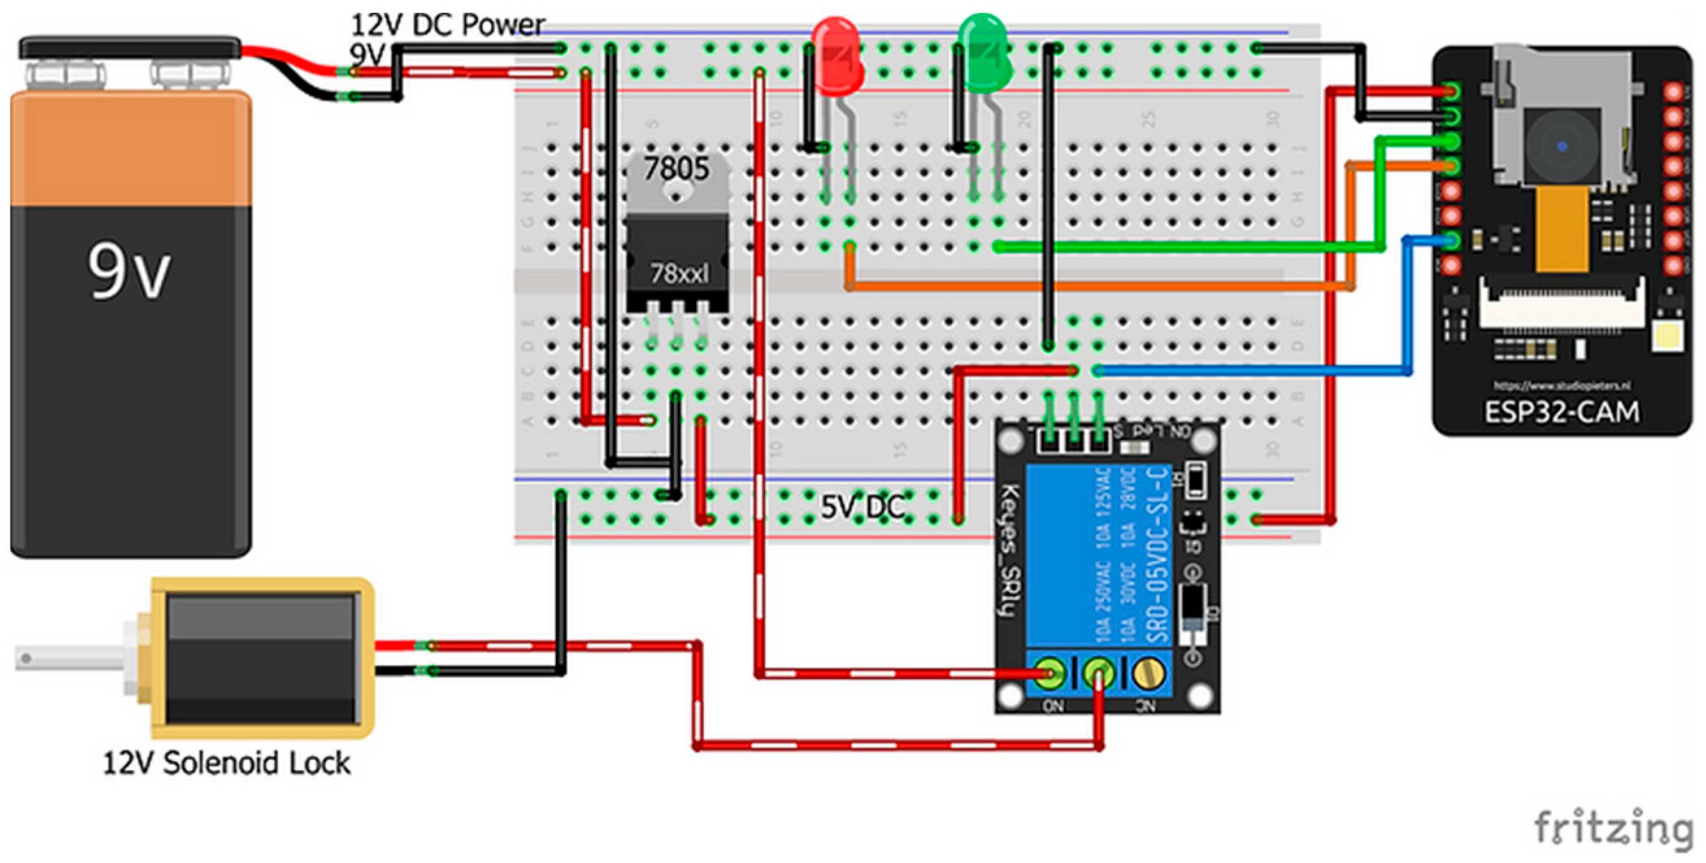
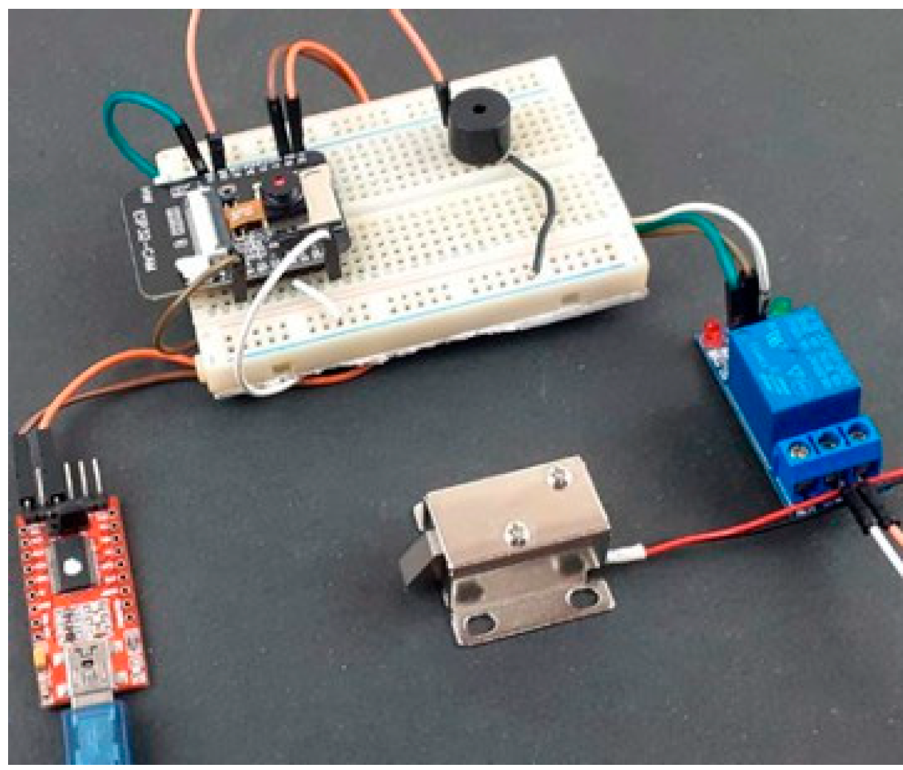
Background & Related work
System configuration and Implementation

Slide 16
Background & Related work
Summary
[V] Remote monitoring and control via Android Application (Blynk) allows access from anywhere.
[V] Visual verification enhances security by allowing the owner to see the visitor's picture before unlocking.
[V] Theft Alert feature triggers a notification and loud buzzer if forced entry is attempted.
[V] Automatic locking feature secures the door if no one enters within five minutes.
[X] Dependency on Internet connectivity – remote operations can be unstable or unavailable if the connection fails.
[X] Performance in poor lighting – visitor identification via the camera may be inaccurate in low light conditions.
[X] Cybersecurity concerns – data encryption and protection against cyber attacks are not fully addressed and require further research.

Slide 17
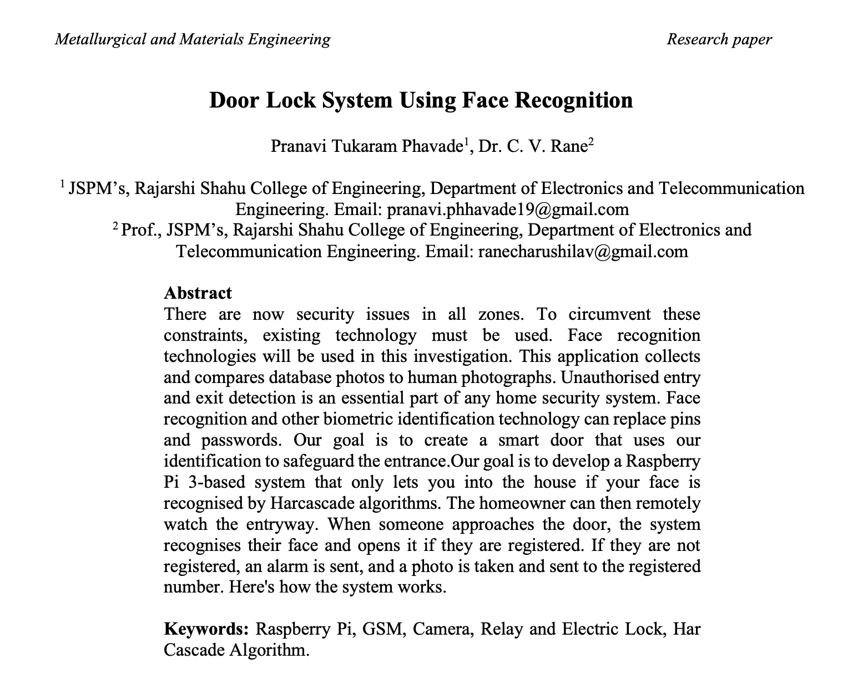
Background & Related work
Title: Door Lock System Using Face Recognition
Authors: Pranavi Tukaram Phavade and Dr. C. V. Rane
Publish date: 2025
Publisher: Metallurgical and Materials Engineering
Article focuses about the problems such as unauthorized entry risks and the inconvenience or insecurity of traditional keys and passwords. Challenges being dealt with are: implementing a hands-free, automated security system using Raspberry Pi for face recognition and GSM for remote alerts.

Slide 18
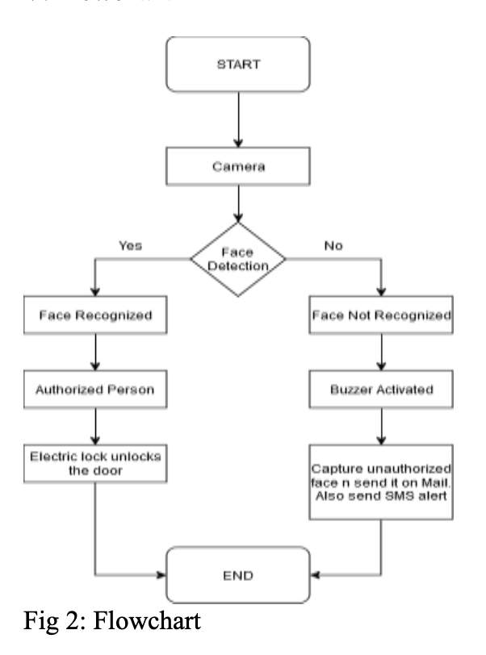
Background & Related work
System configuration and Implementation
Raspberry Pi 4 Model B (Main processing unit handling image analysis and control).
Camera Module / Webcam (Captures real-time images for face detection).
GSM Module (Enables SMS alerts and remote communication via cellular network).
Electric Lock (Solenoid lock powered by 12V for physical door security).
Relay Module (Interfacing component to control the high-voltage lock via the Pi).
Buzzer (Audio output device for alerting unauthorized access attempts).
OpenCV Library (Software library used for image processing and face recognition).
Haar Cascade Classifier (Algorithm implemented for detecting faces in the image).
LBPH Algorithm (Local Binary Pattern Histogram used for recognizing the specific person).

Slide 19
Background & Related work
Results
Recognition Accuracy: The system achieved a recognition accuracy of 92% for known faces using the LBPH algorithm with 20 training images per person.
Processing Speed: Face detection occurs in under 2 seconds under good lighting conditions.
System Response Time: The total time from face detection to the door unlocking ranges between 3 to 5 seconds.
Environmental Limitations: Recognition failures were observed during low lighting conditions, partial occlusions (masks/caps), or drastic changes in appearance (e.g., beard growth) .
Security Feedback: The system successfully displays real-time status on an LCD ("Access Granted/Denied") and sends an SMS/Email alert with the intruder's image for unrecognized faces .

Slide 20
Background & Related work
Summary
[V] High Recognition Accuracy: The system achieves a 92% accuracy rate for known users using the LBPH algorithm.
[V] Enhanced Security Alerts: It features a dual-notification system that sends both an SMS and an email with the intruder's photo upon unauthorized access attempts.
[V] Hands-Free Convenience: The system offers a keyless entry solution, eliminating the risk of lost keys and aiding users with occupied hands.
[X] Lighting Sensitivity: The face recognition performance degrades significantly in low-light conditions or when there is strong backlighting.
[X] Vulnerability to Spoofing: The system lacks "liveness detection," meaning it can potentially be tricked by a photo or video of an authorized user.
[X]Privacy and Scalability Issues: Storing facial data locally on the Raspberry Pi poses a security risk if the device is stolen and limits performance as the number of users increases.

Slide 21


Slide 22
Challenges
Scalability – Maintaining low latency for Face Recognition while supporting scale of hundreds of doors and thousands of users in a commercial building.
Security – Preventing "Spoofing" attacks (using a photo instead of a real face) and securing data transmission against "Replay Attacks" or theft.
Cost-Effectiveness – delivering enterprise-grade biometric security using low-cost hardware (ESP32) compared to expensive market alternatives.
Data Handling & Privacy – Securely managing sensitive biometric data. Storing face images in the cloud (AWS S3) while ensuring strict user privacy and compliance.

Slide 23
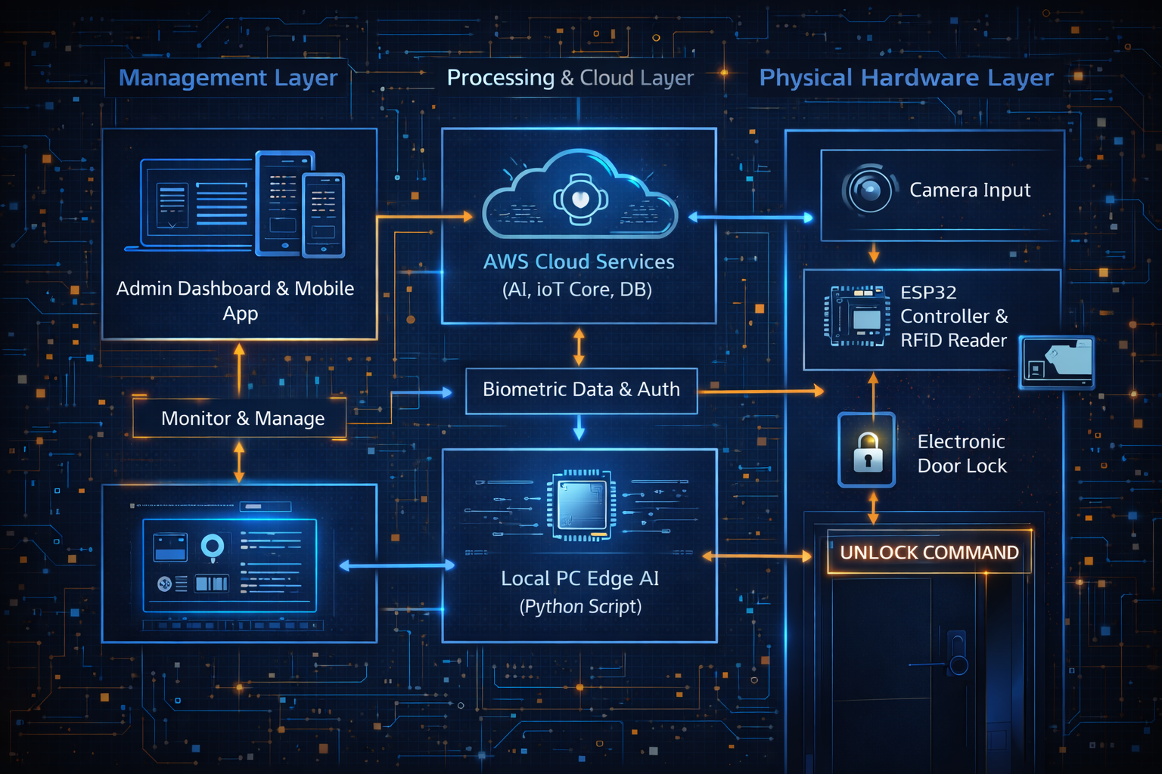
System Architecture

Slide 24
System Architecture
Microcontroller <----> Hardware Sensors
We used: ESP32, RFID-RC522 Reader, Camera (Webcam/OV2640), Electronic Solenoid Lock.
Summary: The ESP32 acts as the main gateway controller. It handles the physical security layer by reading RFID cards and controlling the door lock relay. It communicates status updates instantly over Wi-Fi using the MQTT protocol.

Slide 25
System Architecture
Cloud IoT Services
We used: AWS IoT Core.
Summary: AWS IoT Core is the bridge between our physical hardware and the cloud intelligence. It serves as a secure MQTT Broker, managing real-time command signals ("Unlock Door") between the Python logic script and the ESP32.

Slide 26
System Architecture
Cloud Computing Services
We used: Amazon Rekognition, Amazon S3, AWS IAM.
Summary: We utilize powerful AWS services for heavy processing. Amazon S3 provides secure storage for authorized face images, while Amazon Rekognition performs the complex biometric analysis and face matching with high accuracy.

Slide 27
System Architecture
User Interface Backend
We used: Local Edge AI (Python Script) & Admin Dashboard.
Summary: Our Python-based backend acts as the system's brain. It processes the video feed, orchestrates the API calls to AWS for verification, and visualizes real-time access logs and security alerts for the administrator.

Slide 28
System Architecture
Web Application / Mobile Application
Status: Future Implementation.
Summary: Perhaps in the Future! A dedicated mobile app is planned to allow remote unlocking, viewing of visitor logs, and generating temporary QR access codes for guests from anywhere in the world.

Slide 29
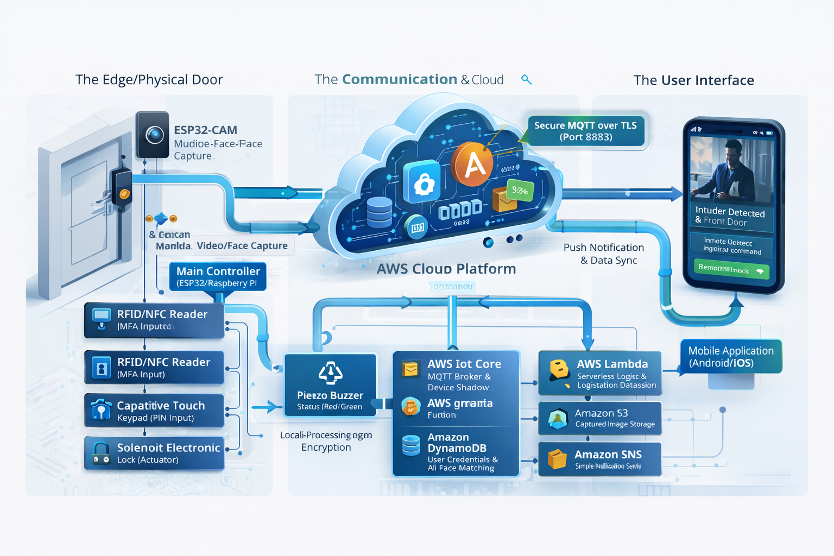
Flow

Slide 30
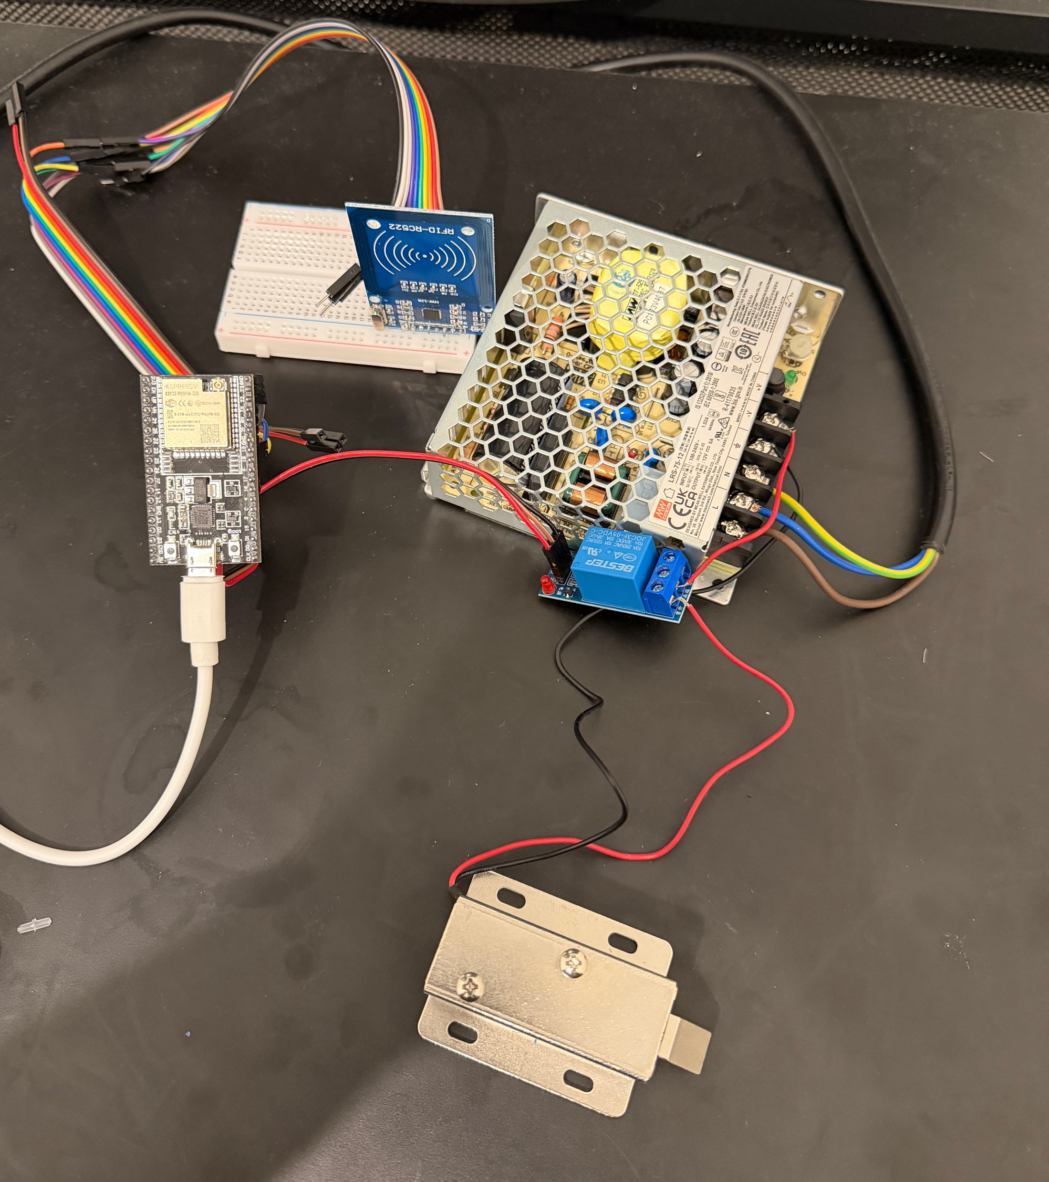
Hardware & Edge Implementation

Slide 31
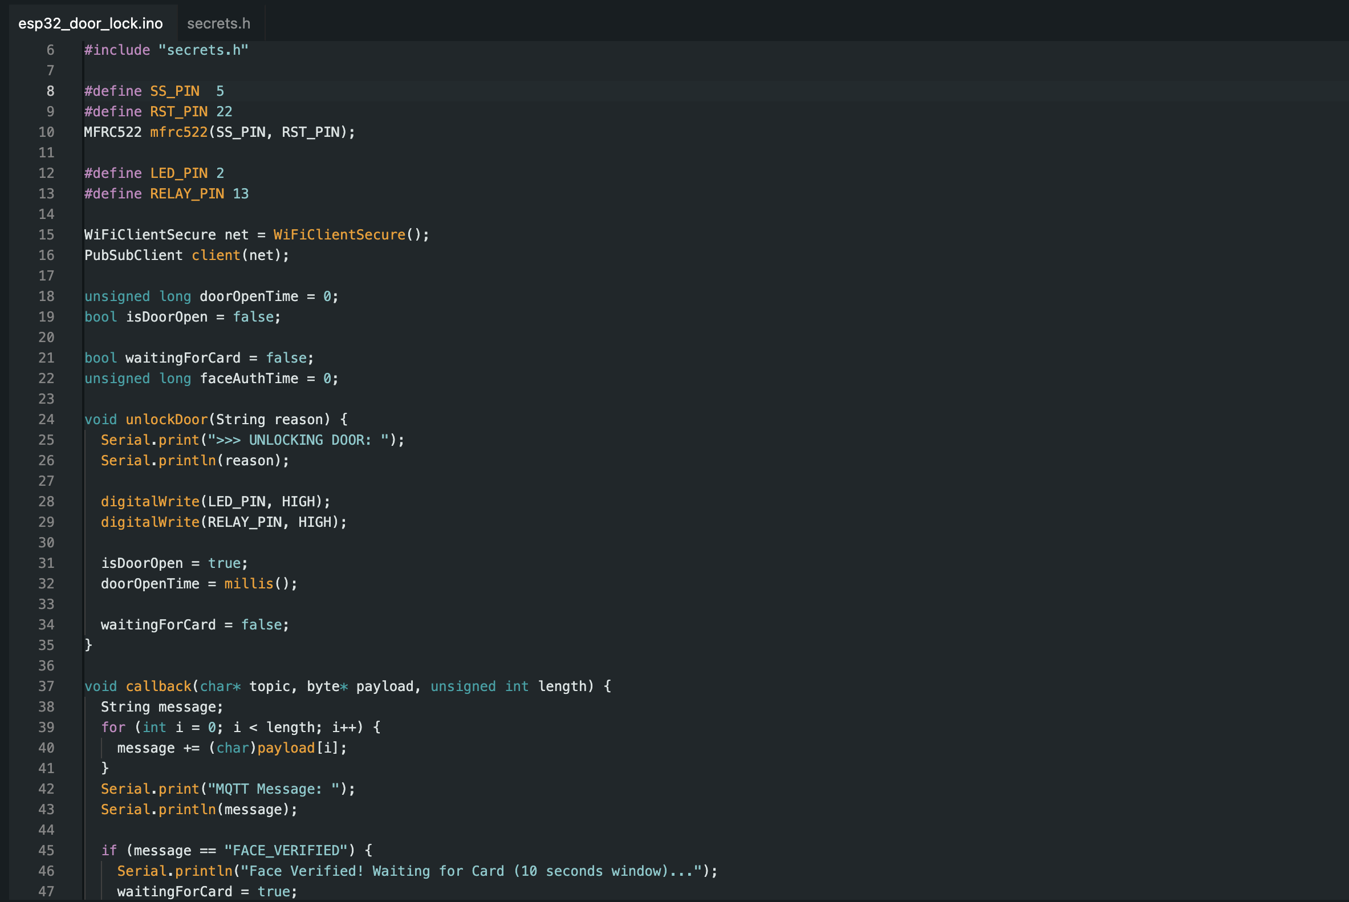
Hardware & Edge Implementation

Slide 32
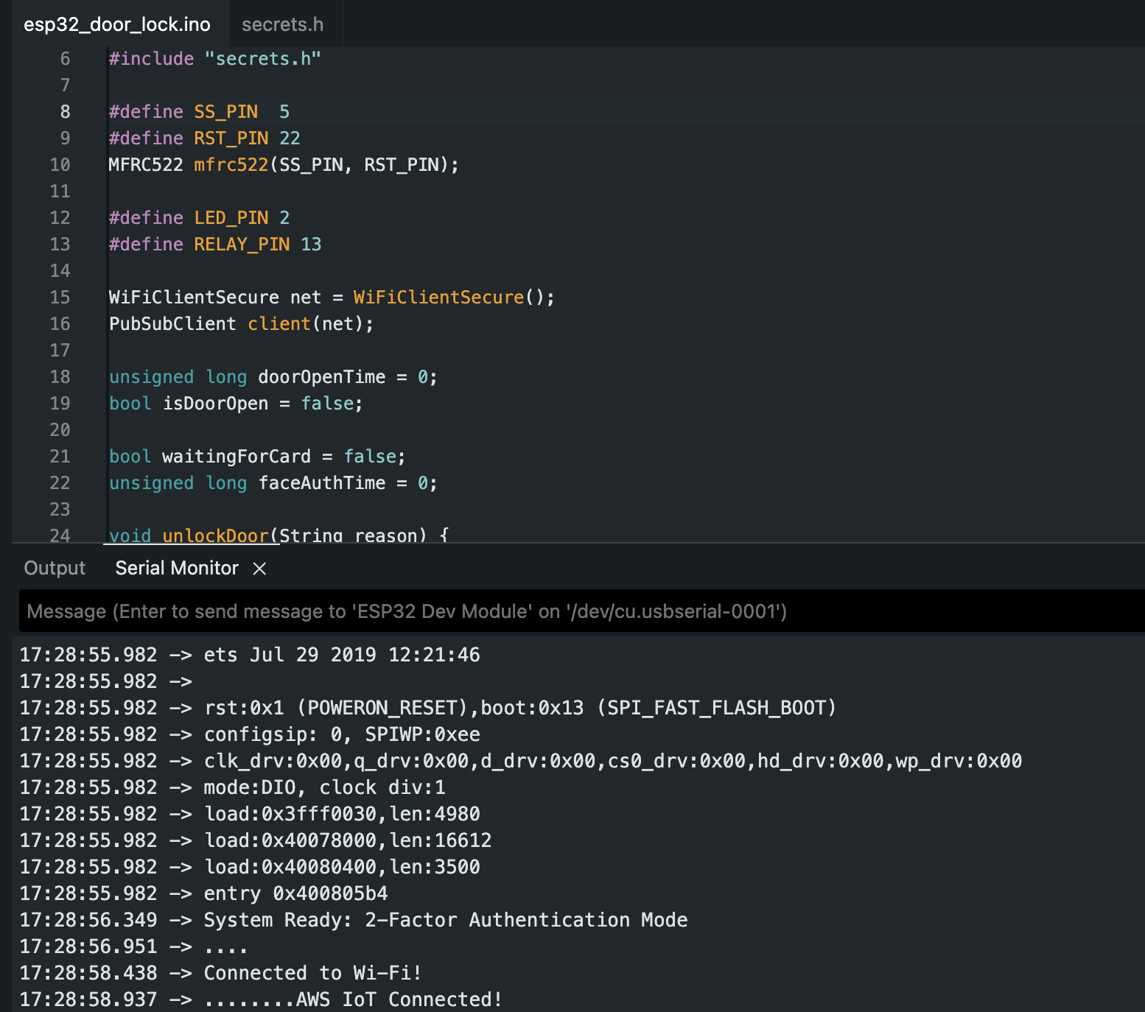
Hardware & Edge Implementation

Slide 33
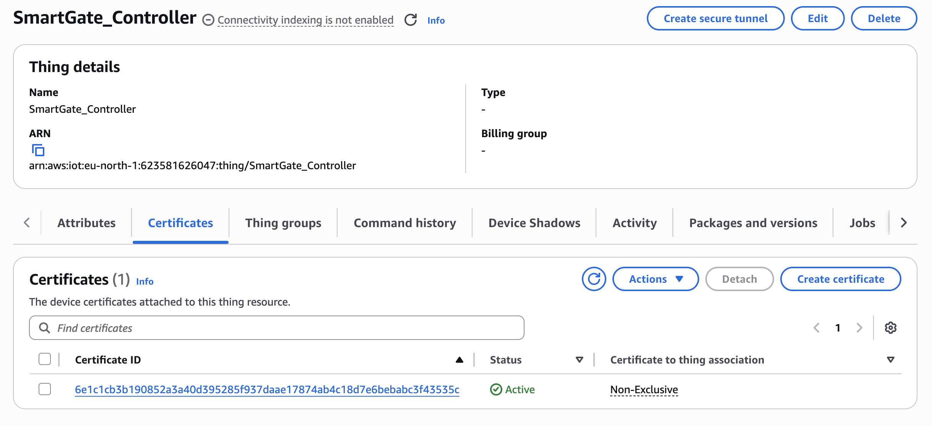
AWS IoT Core Configuration

Slide 34
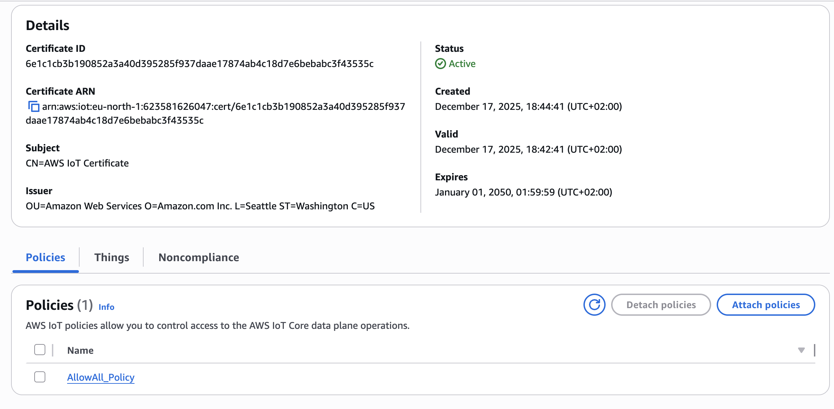
AWS IoT Core Configuration

Slide 35
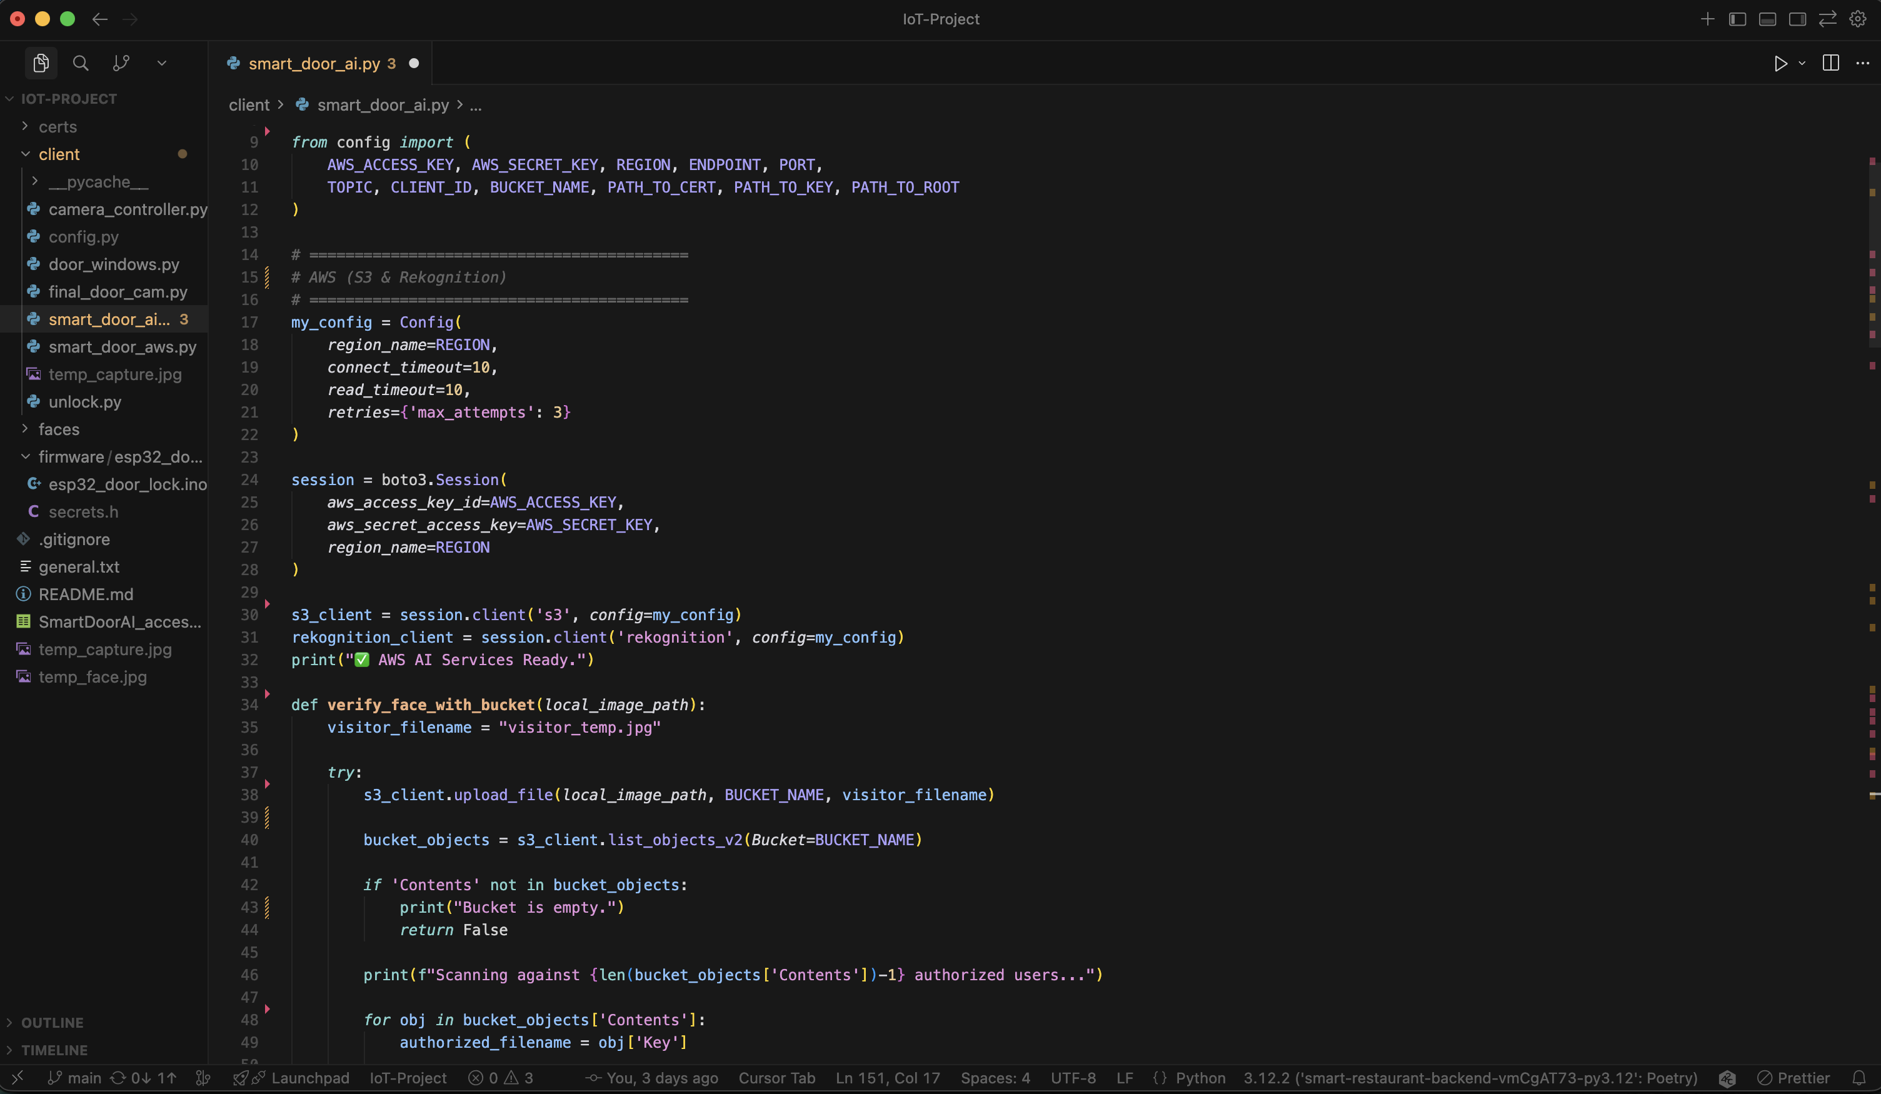
Edge AI & Face Recognition Logic

Slide 36
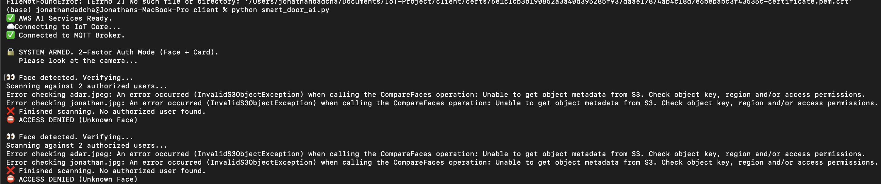
Edge AI & Face Recognition Logic

Slide 37
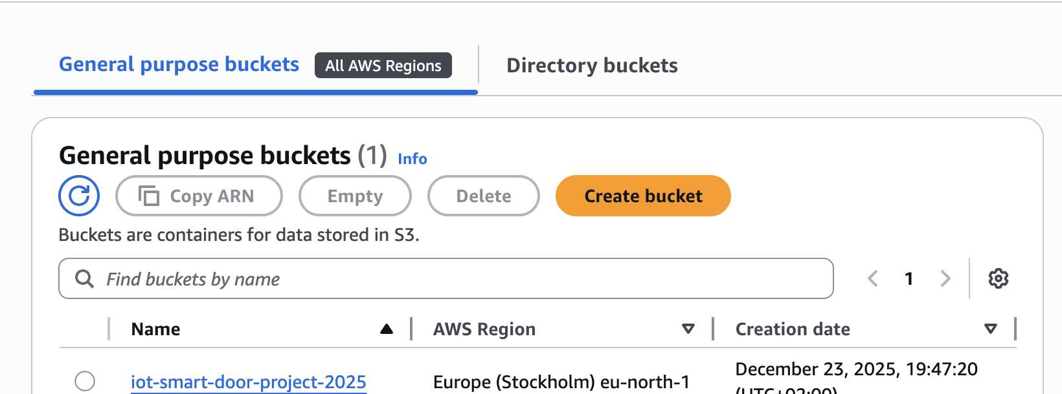
Cloud Storage (S3)

Slide 38
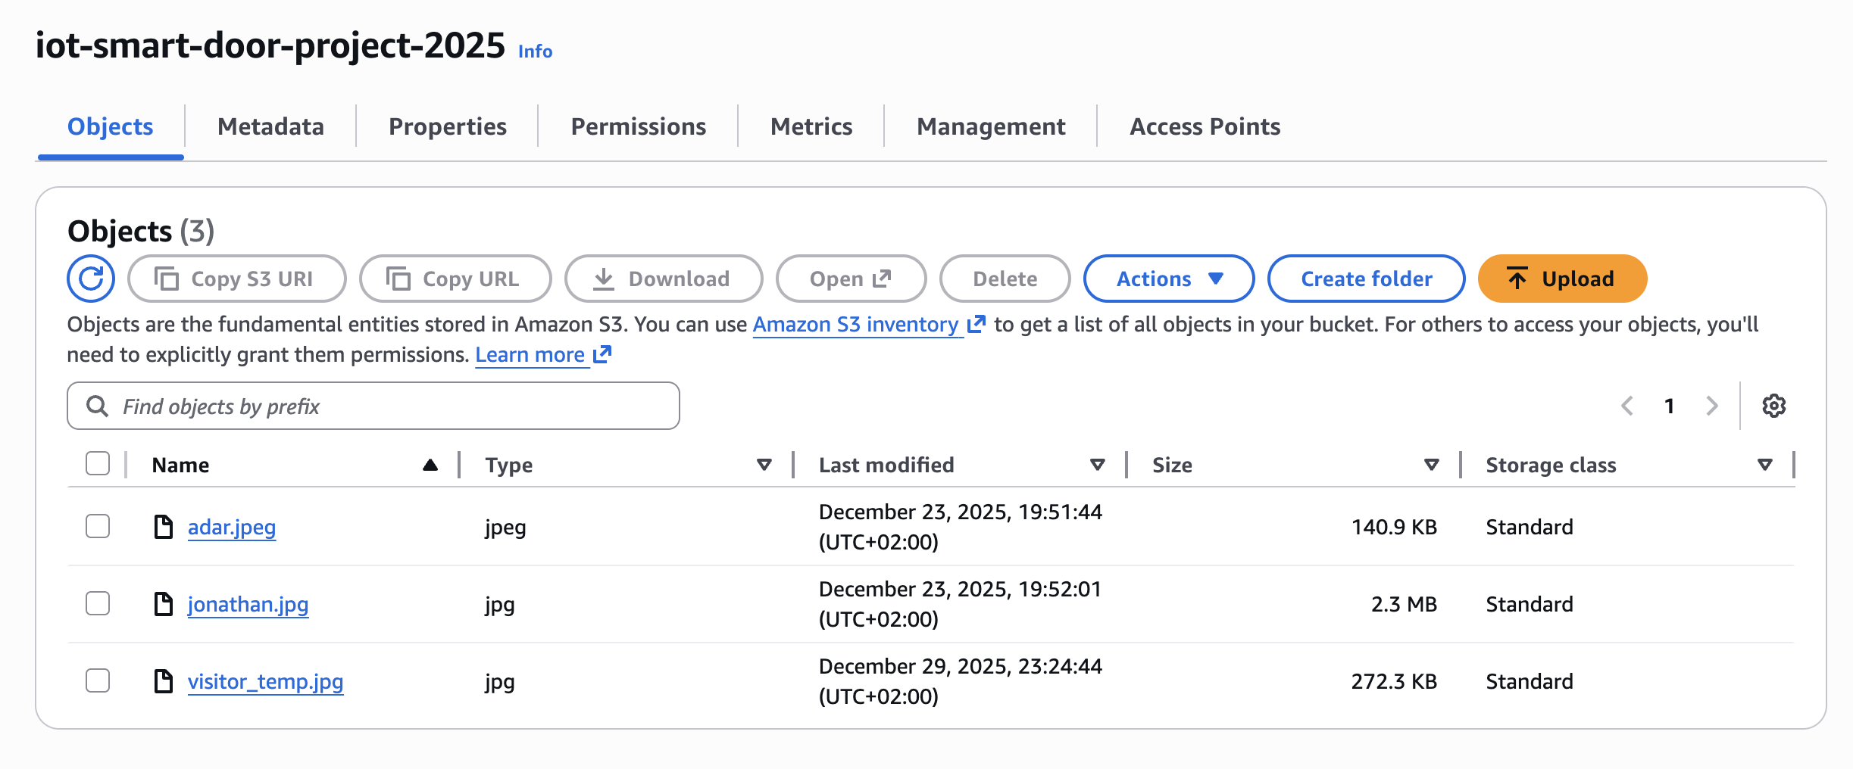
Cloud Storage (S3)

Slide 39
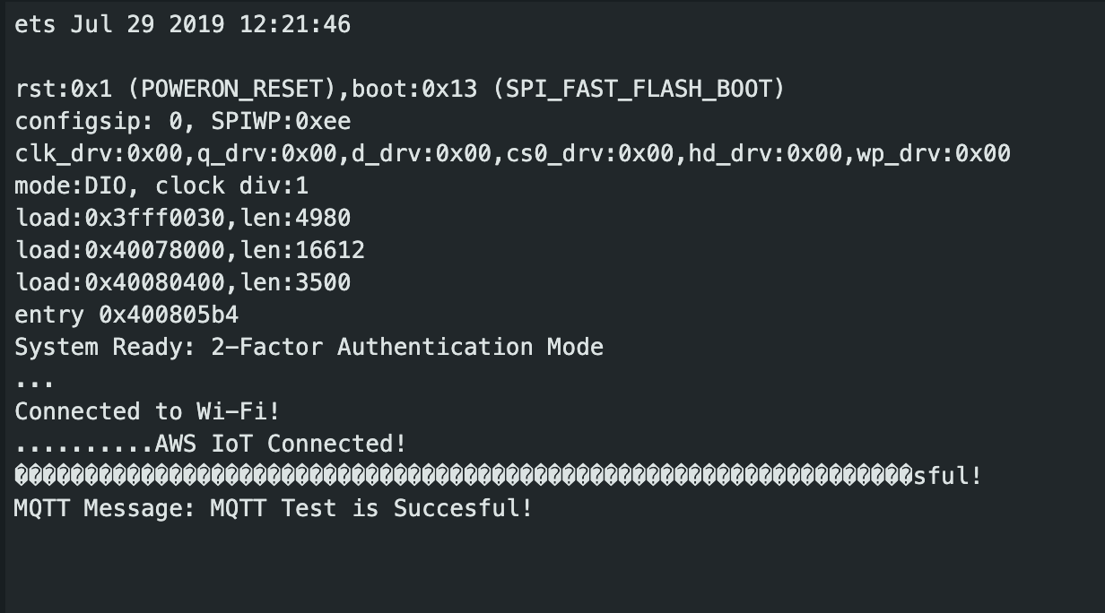
MQTT

Slide 40
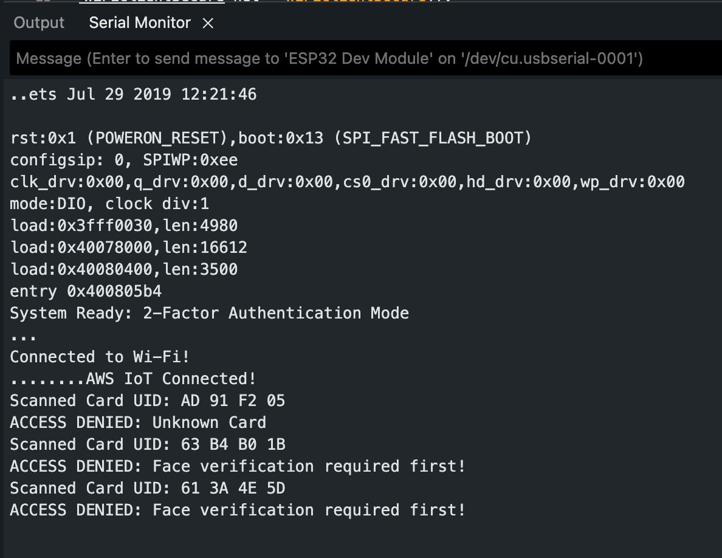
Edge Security Logic (MFA Enforcement)

Slide 41
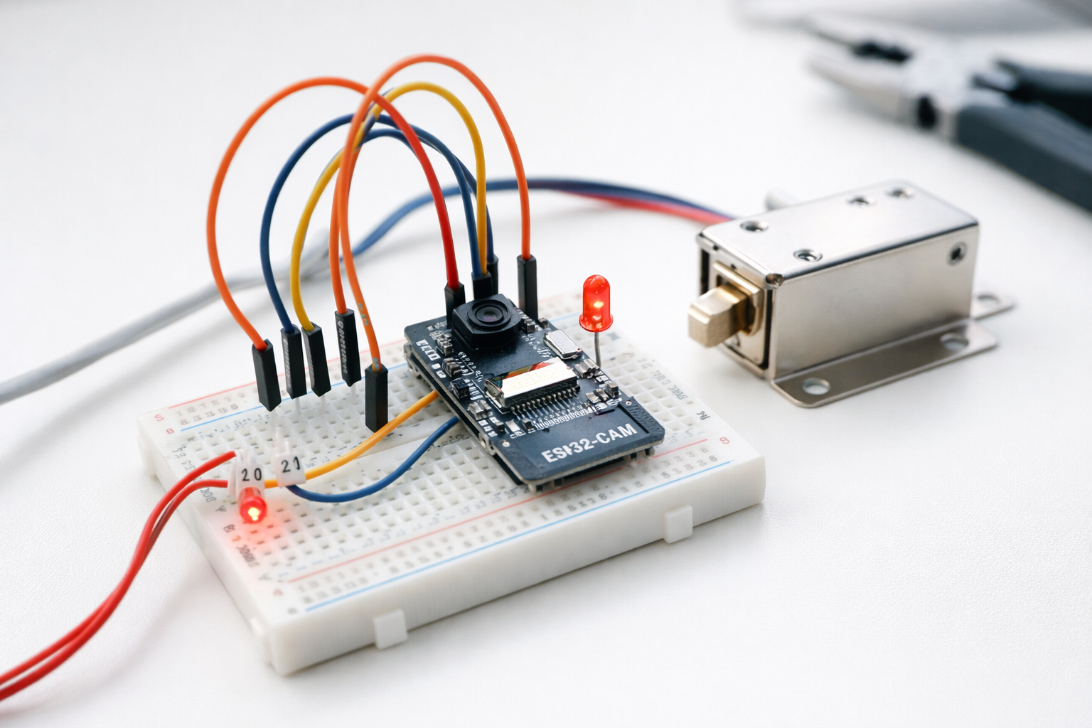
Future ideas

Slide 42
Future ideas
The IoT-based smart door system is designed for scalability and can be easily integrated into broader smart home ecosystems to solve complex security challenges:
Remote Mobile Management – Developing a dedicated mobile app to view real-time entry logs, receive security alerts, and perform remote unlocking from anywhere in the world, eliminating the need for physical presence.
Temporary Guest Access – Implementing a feature for generating time-limited digital keys (QR codes or temporary face registration) for visitors, delivery personnel, or Airbnb guests, removing the need for physical key handover.
Smart Building Integration – Connecting the door system with other smart devices (lights, thermostat, alarm systems) to create a fully automated environment where the house "wakes up" or the office activates based on the specific person entering.

Slide 43


Slide 44
Summary
The need for scalable, smart, and secure physical access solutions is greatly increasing. The IoT Smart Door System is a low-cost solution, using off-the-shelf products such as microcontrollers (ESP32), standard cameras, and powerful cloud services to replace traditional keys with easy-to-develop software.
In a world where biometric data is valuable and privacy is a major concern, it is important to implement systems that protect the user’s personal data with reliable security protocols (like MFA and AWS encryption), without damaging the user experience of a fast, contactless entry.
As smart buildings and cities become the standard, secure and automated solutions as exhibited here must be implemented ASAP.

Slide 45


